Slide 1


Parent / Carer
Feedback
Presented to: Trustee board and Leadership team
Presented on: 15.04.26
Presented by: Jennifer McVeigh, Programme Manager

Slide 2
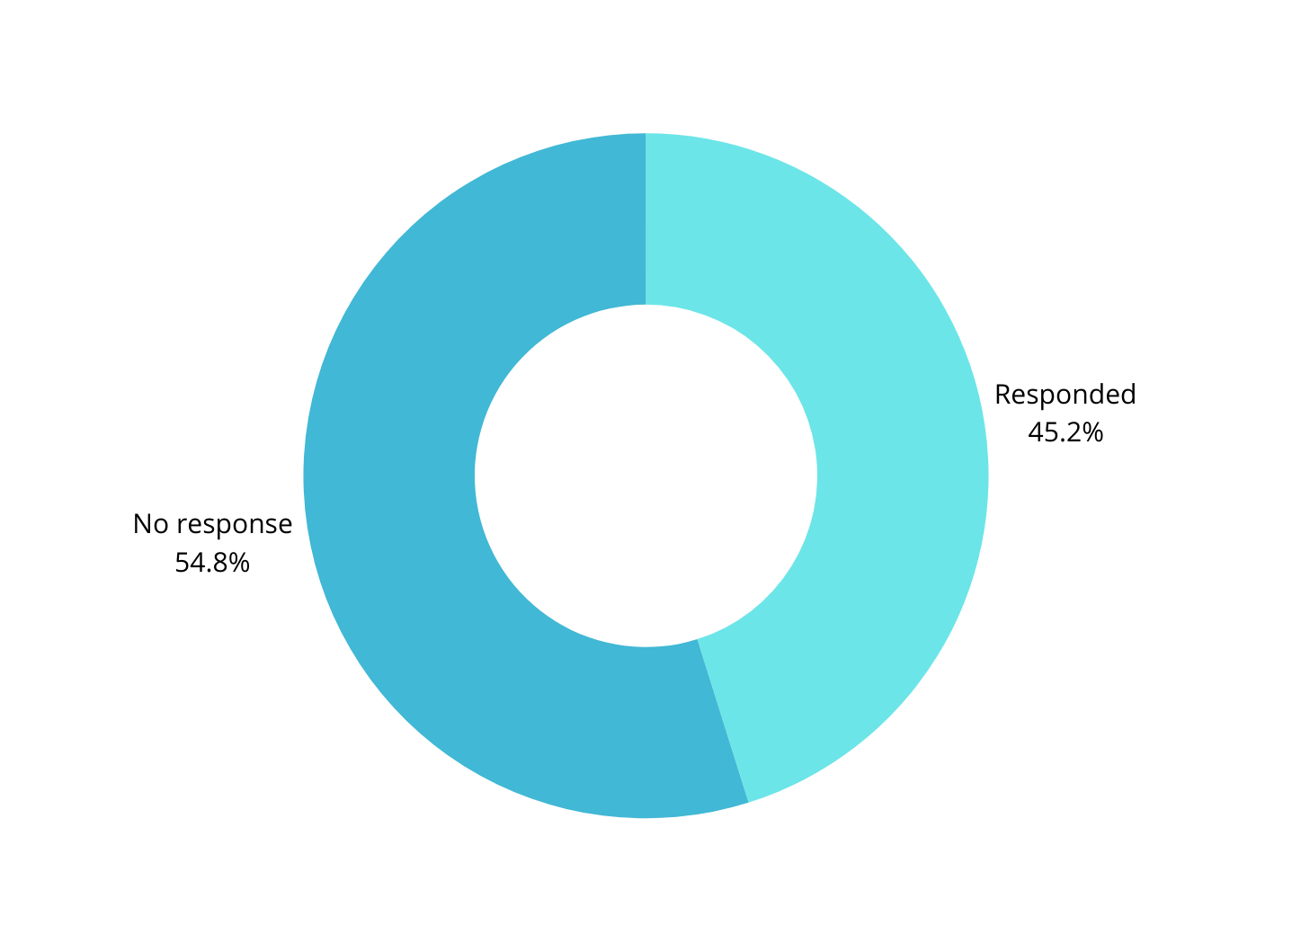
We emailed all parents and carers the following...
“As part of our continuous service improvement and ensuring we are still meeting the needs of the young adults who attend Sapphire, the Board of Trustees have asked if we can gather your views on the service we provide.
Please reply with any feedback you may have from your perspective that would be helpful”
Out of 31 emails sent, we received 14 replies of feedback
100% of the replies were positive

Slide 3

Overview
Overview
Social
Development
Safety
The results presented strong themes around safety, independence, staff quality and social development
Parents reported significant progress at home and in the community and Sapphire was described as unique, valued and essential
We extracted some themes from the feedback...
Staff
Quality
Independence

Slide 4

Safety, Happiness and Wellbeing
Theme
1
Young adults feel safe, relaxed and happy at Sapphire. Parents feel reassured and confident
“Nathan feels safe, has friends and looks forward to going to Sapphire.”
“My son looks forward to attending Sapphire and feels safe and relaxed.”
“His attendance continues to have a positive impact on Harry’s wellbeing.”
“Today, thanks to Sapphire, she’s thriving with learning new skills and making friends.”

Slide 5
Independence and Life Skills
Theme
2
Parents see real progress in communication, confidence and practical life skills.
“They encourage independence wherever possible.”
“Nick enjoys shopping, cooking and taking responsibility for tasks.”
“George is making more eye contact and helping more at home — a massive improvement.”
“Sapphire provides independence skills for home life and work.”

Slide 6
Activities and Opportunities
Theme
3
Sapphire offers a breadth of experiences unmatched by other providers.
“We especially appreciate the staff commitment to residential trips. Sapphire is unique in this aspect.”
“Sapphire offers lots of activities and opportunities that other groups don’t.”
“The greatest variety of activities and opportunities available.”
“Wide range of meaningful and enjoyable activities… a balance of learning, exercise and fun.”

Slide 7
Social Development and Friendships
Theme
4
Young adults are forming friendships and learning to engage with peers as well as becoming active parts of the local community in Bolton.
“He continues to engage himself in conversations, making more eye contact and engaging his listening skills better.”
“The groups are small and all the young people care for each other.”
“Sapphire enables the young adults to meet with friends and develop social skills by talking to each other and learning from doing a wide range of group activities.”
“Sapphire enables young adults to meet friends and develop social skills.”

Slide 8
Family Support
Theme
5
Parents and carers highlighted the support they receive from the staff team and how the level of support offered is unique to Sapphire
“You are always at the end of the phone when we have needed support.”
"Personally, all the staff have supported my family with friendship”
“Sapphire not only offer support to Harry but to us as a family, which is sometimes needed.”
“I must also commend Dee, who has attended meetings, offering her knowledge and support.”

Slide 9
Staff Team
Theme
6
Staff are consistently praised for kindness, skill and commitment
“All the staff are very dedicated, very friendly and approachable”
“The staff are caring and kind while maintaining a disciplined attitude.”
“We are reassured by the care and support given by the wonderful team.”
“Staff are very nice and accommodating.”

Slide 10

Quality & Effectiveness of the Provision
The feedback provides evidence that Sapphire is:
Safe, trusted, and well-run
Delivering positive outcomes
Meeting both young people’s needs and family expectations
This strengthens the organisation’s quality assurance narrative and reduces risk.
Impact

Slide 11
Demonstrates Strong Market Differentiation
Parents repeatedly state that Sapphire:
Offers activities and opportunities other providers don’t
Provides residential experiences and respite not available elsewhere
Delivers a unique blend of life skills, community engagement, varied activities and care
This positions Sapphire as a distinctive, high-value service, not easily replaceable.
Impact

Slide 12
Supports Sustainability & Growth
High satisfaction leads to:
Continued attendance and requests for additional days
Strong reputation through word of mouth
Increased likelihood of local authority confidence and referrals from social care
Positive feedback directly supports income stability and long-term viability.
Impact

Slide 13
Positive Outcomes Beyond the Setting
Feedback highlights:
Skills transferring into home and community life
Improved confidence, communication, and behaviour
Reduced family stress through reassurance and respite
Stronger community links
This shows Sapphire delivers real-world impact, not just activity-based provision.
Impact

Slide 14

An email from a parent...
“DEFINITION:
Sapphire Partnership - providing the greatest variety of activities and opportunities available, constantly seeking out and evaluating new possibilities, combined with practical life skills training, health & wellbeing, interpersonal skills and communication mentoring, and constant support for parents
…what would we all do without you?!”

Slide 15
Thank you very much!

